Slide 1




LENDI INSTITUTE OF ENGINEERING AND TECHNOLGOY
(Autonomous)
Approved by AICTE and Permanently affiliated to JNTU Gurajada-Vizianagaram.
ECE,EEE,CSE&MECH
DEPARTMENT OF COMPUTER SCIENCE AND ENGINEERING
NAME OF THE SUBJECT :
NAME OF THE TOPIC :
PRESENTED BY :
Mr. N P PATNAIK M
Assistant Professor

Slide 2
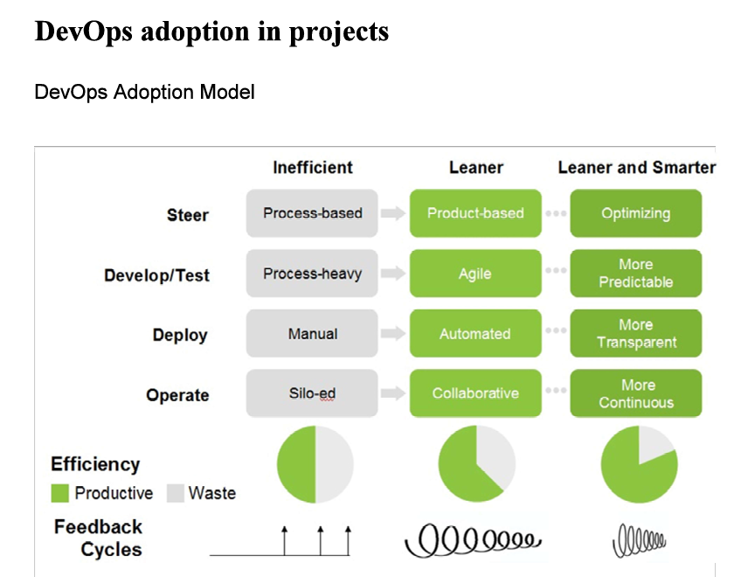

Slide 3
DevOps practices in projects into three stages:
Inefficient
Leaner
Leaner and Smarter.
Each stage is characterized by different approaches to
Steering,
Development
Testing
Deployment
Operations

Slide 4
Steer:
Inefficient: Process-based.
Leaner: Product-based.
Leaner and Smarter: Optimizi

Slide 5
Develop/Test:
  Inefficient: Process-heavy.
  Leaner: Agile.
  Leaner and Smarter: More Predictable.

Slide 6
Deploy:
  Inefficient: Manual.
  Leaner: Automated.
  Leaner and Smarter: More Transparent.

Slide 7
Operate:
Inefficient: Silo-ed.
Leaner: Collaborative.
Leaner and Smarter: More Continuous

Slide 8
To address the broader aspects of DevOps adoption in projects, including technology, agile capabilities, tool stack implementation, people, and processes, here are some considerations:
Technology Aspects: Focus on automation, continuous integration/continuous deployment (CI/CD) pipelines, and infrastructure as code (IaC).
Agile Capabilities: Emphasize iterative development, cross-functional teams, and continuous feedback.
Tool Stack Implementation: Select tools that integrate well and support automation, monitoring, and collaboration.
People Aspect: Encourage a culture of collaboration, continuous learning, and shared responsibility.
Processes: Streamline workflows, reduce bottlenecks, and ensure processes are adaptable and scalable.

